Slide 1
Participant Accrual
MTN-025 Study Specific Training

Slide 2
HOPE Accrual Targets
What are the target accrual numbers for HOPE?

Slide 3
HOPE Accrual Targets
What are the target accrual numbers for HOPE?
There are no set accrual targets for HOPE. The goal is to offer participation to all former ASPIRE participants, not enroll a certain number of former participants.
Notes:
Enrollment in previous OLEs (e.g. iPrEX or Partners) is a range – anywhere from 65-85%. We expect it will be similar for HOPE. The key is to fully educate about HOPE and allow participants the opportunity to join, not to push enrollment on participants who may not be interested. Take home: it is okay if a participant does not choose to enroll in HOPE.

Slide 4
HOPE Accrual: Goals
All former ASPIRE participants who meet eligibility criteria will be offered enrollment in HOPE/MTN-025
Participants who decline participation in MTN-025 but meet decliner group eligibility criteria will be offered enrollment into the decliner population
Notes:
More on the decliner population soon!

Slide 5
ASPIRE Final Enrollment Numbers
 | Total Enrolled (ASPIRE)
Blantyre | 130
Lilongwe | 142
Cape Town | 166
CAPRISA | 244
MRC/Botha's | 180
MRC/Chatsworth | 150
MRC/Isipingo | 117
MRC/Tongaat | 103
MRC/Verulam | 150
MRC/Umkomaas* | 103
WRHI | 213
Kampala | 253
Seke | 224
Spilhaus | 230
Zengeza | 224
Notes:
Plans for contact of all former ASPIRE participants should be outlined in site specific SOPs

Slide 6
Accrual Timelines
Accrual is targeted to be completed within approximately 6 months of site activation
Sites are encouraged to start slow, and then scale up recruitment
Notes:
Evaluations of performance will be ongoing throughout the accrual period. Discussions will be held with sites if or when there are any recommendations to modify accrual plans. Adjustments may be made after MTN Study Monitoring Committee reviews of MTN-025.

Slide 7
Accrual Timeline
What if a participant presents for enrollment after the 6 month accrual period has ended?
Notes:
(i.e. HOPE will close to accrual 4 months ahead of the anticipated closure of the study).
Guidance on adjusted follow-up schedules will be issued by the management team when the formal accrual period has ended. Sites will be notified as needed to stop screening.

Slide 8
Accrual Timeline
What if a participant presents for enrollment after the 6 month accrual period has ended?
In an effort to provide women with the maximum ability to enter HOPE, participants will continue to be enrolled throughout the duration of the trial, provided that at least 4 months of time on study is supported by the timeline
Notes:
(i.e. HOPE will close to accrual 4 months ahead of the anticipated closure of the study).
Guidance on adjusted follow-up schedules will be issued by the management team when the formal accrual period has ended. Sites will be notified as needed to stop screening.

Slide 9
Pre-Screening/Recruitment Procedures
Sites are encouraged to implement pre-screening procedures for MTN-025 as part of their outreach and recruitment strategy.
Educate participants about MTN-025
Ascertain elements of presumptive eligibility, to be confirmed at an on-site screening visit
Notes:
For example, prescreening could cover behavioral and basic demographic eligibility criteria, such as (but not limited to):
Current breastfeeding, or pregnancy intentions
Current contraceptive use, and intention to continue use
Willingness to comply with other protocol requirements, such as:
Attendance at study visits for approximately 1 year and associated HIV and pregnancy testing
Non-participation in other research studies

Slide 10
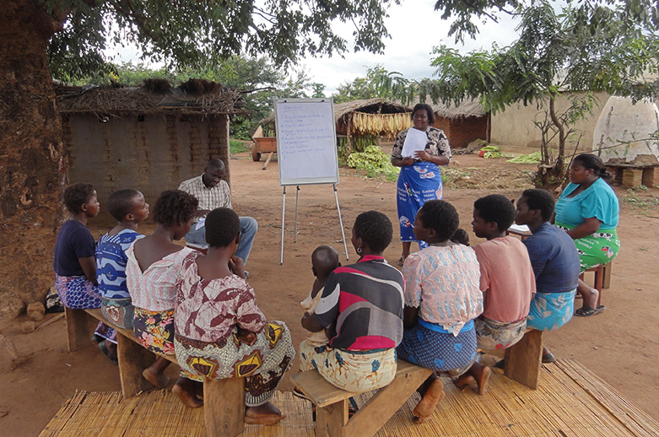
Education and Pre-screening
What are your site-specific plans to educate participants and the community about HOPE? What materials will you use?
What prescreening tools/procedures will you utilize, if any?
Who will be responsible for making recruitment contacts?

Slide 11
Recruitment Contacts
Each site must develop a system to track all recruitment contact(s) and outcomes (e.g., a log, recruitment contact sheets) which should include:
Scheduled for MTN-025 screening visit
Scheduled for a MTN-025 decliner screening/enrollment visit
Reason for not contacting the participant to screen/enroll in either cohort (e.g., unable to contact, ineligible based upon ASPIRE information: seroconverted, permanently discontinued from product, deceased, participant did not provide permission to contact for future studies, etc.)
Notes:
A PTID list of all former enrolled ASPIRE participants will be provided by SDMC to help sites track recruitment activities.
Why was the ASPIRE participant not contacted to participate in HOPE?
unable to reach participant
participant was permanently discontinued from study product during ASPIRE
participant HIV seroconverted during ASPIRE
participant deceased during ASPIRE
participant did not provide permission to be contacted for future studies
other, specify: _______

Slide 12
Up Next from SCHARP….
Recruitment Lists
Prescreening ID Assignment
Pre-screening Outcome CRF

